Slide 1

Bytes are all you need: Transformers operating directly on File Bytes

Slide 2
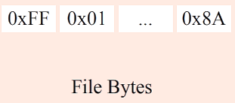
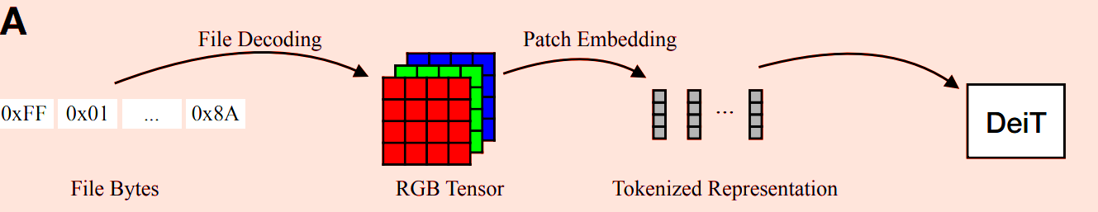
Introduction:
Any Image, audio, video or text in the simplest form is stored on memory as bytes(or bits).
As of now if a user wants to perform inference on a file stored on disk(image or audio),the user must first decode the file into modality-specific representation.
Image file encodings – fHWC,fCHW,TIFF,PNG,JPEG.
Audio file encodings – WAV,MP3

Slide 3
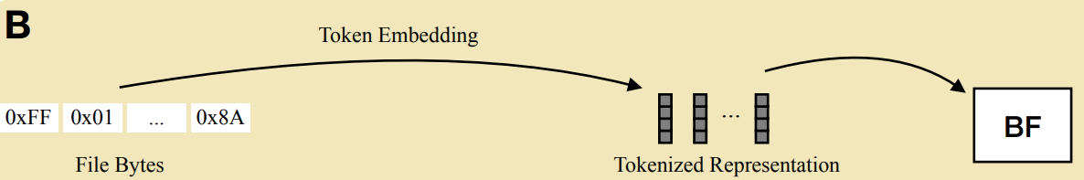
Drawbacks of decoding inputs into modality specific representation:
It requires handcrafting an input representation for each input modality.
It reduces privacy by exposing the data being analyzed.
A common property of many input modalities is that they can be stored as file bytes.

Slide 4
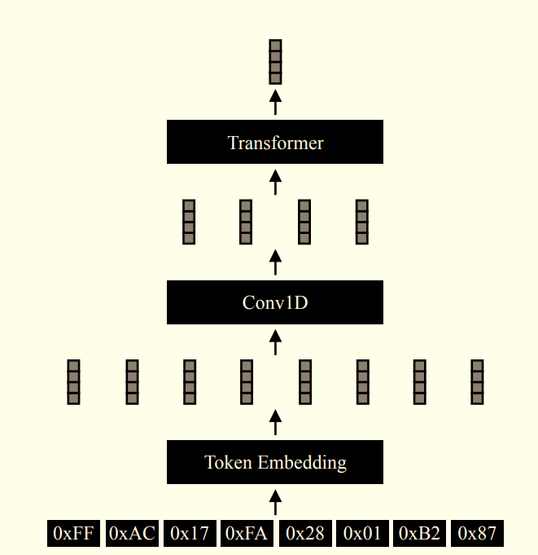
Overview of Architecture of ByteFormer:
Map the byte values to learned vectors using learned token embedding.
Apply a Conv1D to reduce token dimension(window=k, stride=k/2). The intuition for choosing Conv1D is that neighboring file bytes often contain related information
Pass the features to the Transformer backbone.
After passing our tokens through the transformer, we average the embeddings across the sequence dimension.
Backbone Transformer used – DeiT-Ti
On ImageNet Classification Dataset:
DeiT-Ti achieves 72.2% accuracy on RGB inputs.
ByteFormer achieves 77.33% accuracy on files stored in TIFF format.
ByteFormer can achieve 95.8% accuracy on Speech Commands v2 dataset, comparable to SOTA(98.7%) without any architecture changes or hyperparameter Tuning.

Slide 5
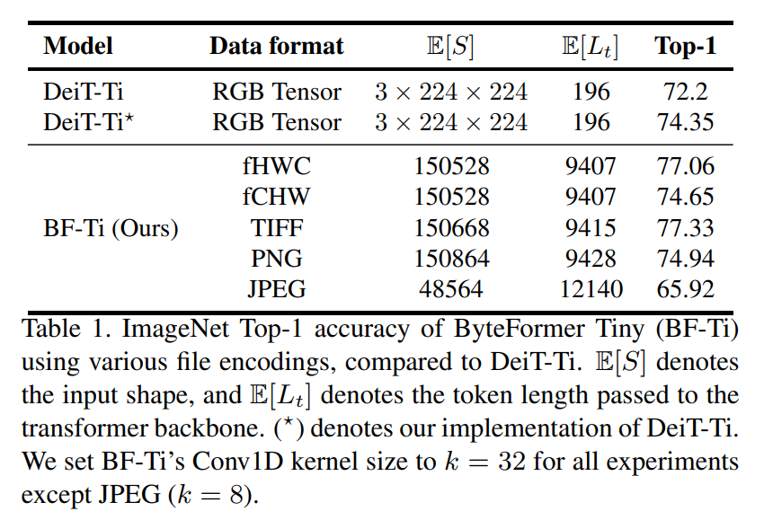
Details of Training and Inference:
At training time, we decode the file(e.g. read the contents to RGB tensor in case of images), then form standard training augmentation(e.g. random cropping in the case of images), then save the result in desired file encoding.
Training method is implicitly dependent on the input modality due to our augmentation.
At inference time, we do not need the knowledge of input modality. We need to ensure that our model inputs use the correct file encoding. E.g. for TIFF experiments on ImageNet, we precompute 224x224 crops of the validation images and save them in TIFF format.

Slide 6
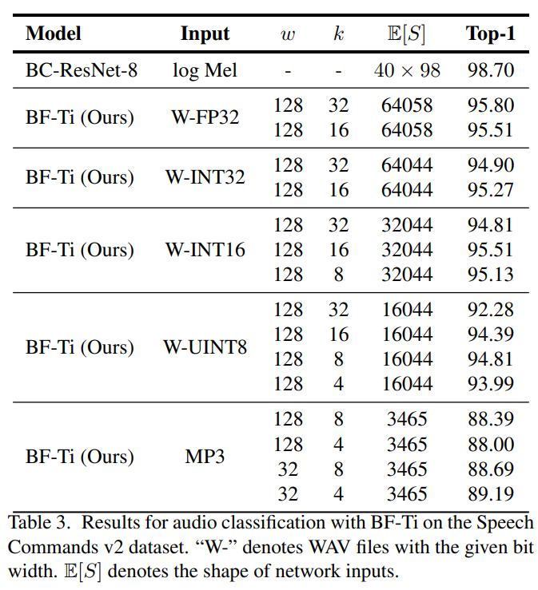
Performance on Speech Commands V2 :
BF-Ti achieves accuracies of up to 95.51% on WAV files, comparable to the SOTA BC-ResNet-8.
BC-ResNet-8 is specifically designed for audio processing. In contrast, no parameter tuning is done relative to ImageNet training.
Influence of k on model accuracy:
In general , optimal k decreases when the expected number of input tokens decreases.

Slide 7
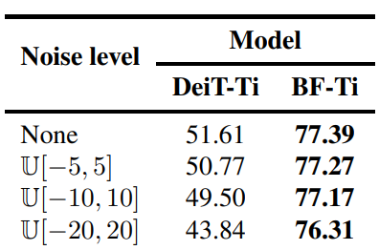
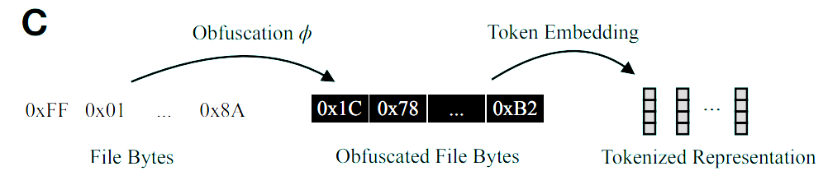
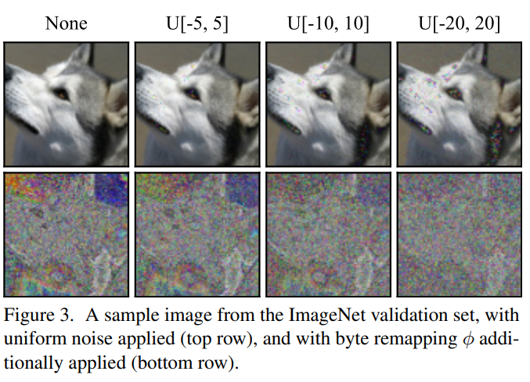
Applications : Inference on Obfuscated inputs
We observe that byte remapping retains shape information. A region of the image that is dominated by a single pixel value will continue to be dominated by a new (remapped) pixel value
To alleviate this, we add noise from a uniform distribution U[−a, a] sampled from −a to a (inclusive) to each pixel channel independently, then compute the result modulo 256.
We observe that BF-Ti is resilient to this transformation
Suggest that decoupling the input representation from the model can lead to new possibilities for building more secure systems.

Slide 8
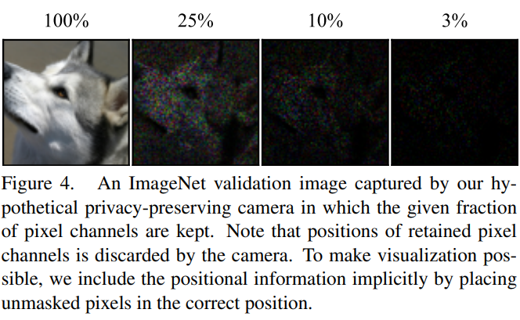
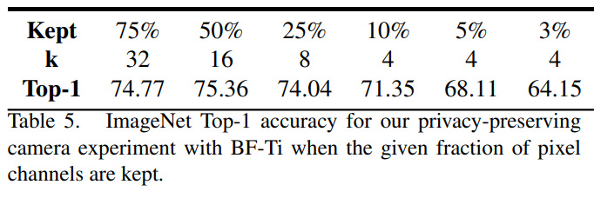
Applications : Privacy Preserving Camera.
Considering a hypothetical camera that masks out a large fraction of its pixel channels.
The camera stores the remaining unmasked pixel channels in an array without retaining the co-ordinates.
In this scenario, an adversary could not obtain a faithful reconstruction of input image.
At 10% pixel retention, the content of image is hard to visually perceive. But, the accuracy of the model is 71.35%, comparable to the original DeiT-Ti model on unmasked images.

Slide 9
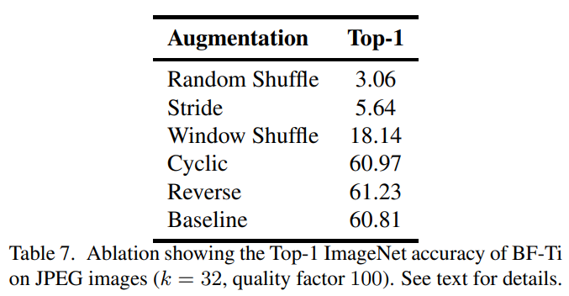
Effect of Byte Ordering:
Does Byte transformer simply learn byte frequencies, or is the byte ordering relevant?
We find that the model is sensitive to locality, and does not only learn byte frequencies.

Slide 10
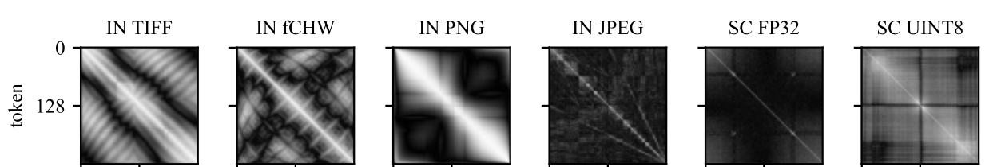
Analysis on Learned Token Embeddings:
The pattern varies substantially across input encodings and tasks.
In TIFF, PNG, and fCHW, we observe a bright band on the diagonal , corresponding to high correlation between bytes and their neighbors.
This does not hold for JPEG due to Huffman encoding step.
The correlation between token embeddings in the fp32 encoding of Speech Commands is generally weak.
It may be because the fp32 audio amplitude value is split across four bytes in the file encoding, weakening the association between byte values and amplitudes.

Slide 11
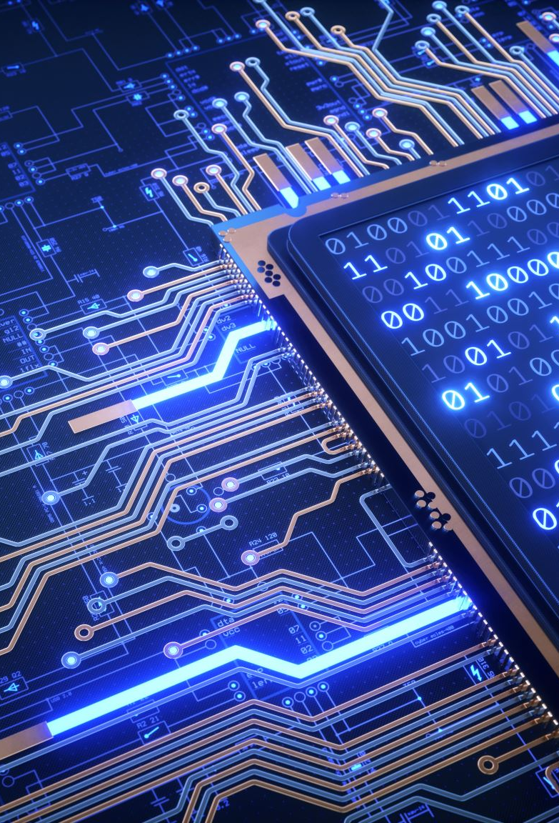
Limitations and Future Work:
The accuracy of ByteFormer depends on the file encoding chosen. FW- Adding invariance to file encodings.
Our choice of ϕ for our obfuscation method does not provide cryptography-level security against an attacker with access to a large set of model inputs. FW- Taking this method as a building block to design thoroughly analyzed, secure systems.
This method has only been evaluated on classification for images and audio. FW- Experimenting with other domains (video, text)

